Slide 1
Cloud Patterns
Day 5

Slide 2


Who am I?
Senior Integration Consultant
Datacom New Zealand
Twitter: @alessandromoura
Blog: www.alessandromoura.com.br
Linkedin: https://www.linkedin.com/in/alessandromourabr/

Slide 3
Agenda
Challenges faced in Cloud Development
How Design patterns address these challenges
Catalogue of Key patterns used in Azure Apps Solutions
Category & problem
Solution
Usage scenarios

Slide 4
Challenges in Cloud Development
Availability and Resiliency
Scalability and Performance
Interoperability
Data Solutions
Security
Management and Monitoring

Slide 5
Availability and Resiliency
Build availability in all components to meet the defined SLAs
Build resiliency to handle errors gracefully
Recover from Failures of all types – Transient and Permanent
Notes:
Non-Functional requirements
Talk about doing a solution with building blocks and the SLAs between those blocks

Slide 6
Scalability and Performance
Meet changes in demands by scaling automatically
Scale both compute and data tiers
Optimise the use of resources and cost
Maintain performance levels with increase in scale

Slide 7
Interoperability
Modern application designs today take advantage that cloud provides for scalability, and wide reach by distributing and scaling components and data across regions.
A lot of time there is dependency on legacy systems which cannot be changed
Microservice architectures involve creating self autonomous services that need to seamlessly find and communicate with each other
The scaled out and distributed architecture needs the design to use asynchronous communication bringing challenges like ordering of messages, timely delivery of messages, idempotency etc

Slide 8
Data Management
Cloud applications are designed to be highly scalable and available. This also means that data stores and services used are also distributed across locations for performance, HA and scalability
This poses a challenge of data consistency and synchronization
Partitioning and distributing Data is also another popular design bringing with it maintenance challenges

Slide 9
Security
Security poses a big challenge to organizations that want to host applications on the cloud. While cloud brings a lot of advantages of scale and availability, it also brings security challenges
Cloud applications are typically hosted on public internet and are exposed to malicious attacks, untrusted user access
As cloud applications are also hosted on vendor data centers, data integrity, protection and encryption are essential to maintain and need to be specifically designed for sensitive information

Slide 10
Management and Monitoring
To ensure High availability and resiliency for cloud applications, designing the correct monitoring solution is essential
As the physical infrastructure and in case of PaaS the virtual platform is managed by the vendor, customers need to instrument applications to provide necessary application specific parameters for monitoring and managing it

Slide 11
Cloud Design Patterns
What is a design pattern?
A general reusable solution to a commonly occurring problem
Best practice solutions for common software design problems
They provide a template for solutions to problems
As the world of cloud services changes and more innovations are made - design pattern may become obsolete over time
Generally defined using
Name for the Design Pattern
Description - to be applied to solve a problem that can occur in different situations during the design process
Problem - That the pattern addresses/Where it can be applied
Solution - describing the elements of the pattern with the relations and their consequences
Consequences, results, and constraints resulting from the application of the pattern.

Slide 12
Ambassador

Slide 13
Category, Description, Problem
Ambassador
Category | Management & Monitoring, interoperability
Description | Create helper services that send network requests on behalf of a consumer service or application.
Problem | It may be difficult or impossible to update legacy applications or existing code libraries to add features like routing, metering and monitoring required by cloud applications, because the code is no longer maintained or can’t be easily modified by the development team.

Slide 14
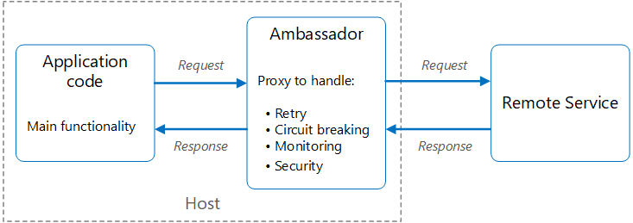
Solution
Ambassador
Create external process that acts as a proxy between your application and external services with needed features
Deploy on the same host environment
Allow control over routing, resilience, security features
Avoid any host related access restrictions
Managed independently of the application
Notes:
Put client frameworks and libraries into an external process that acts as a proxy between your application and external services
Deploy the proxy on the same host environment as your application to allow control over routing, resilience, security features and to avoid any host related access restrictions
Features that are offloaded to the ambassador can be managed independently of the application. You can update and modify the ambassador without disturbing the application’s legacy functionality
Service A calling Remote Service A
Extra services:
Retry – short term failures
Circuit breaking – long term failures
Monitoring
Security
Service B calling Remote Service B
Service C calling Remote Service C
DRY (don’t repeat yourself )
Avoid duplications
Adding tiny changes will create a good amount of effort
Dedicate a specific container for each Service to avoid dependency

Slide 15
Usage Scenarios
Ambassador
When to use this pattern
Need to build a common set of client connectivity features for multiple languages or frameworks
Need to offload cross-cutting client connectivity concerns to infrastructure developers or other more specialised teams
Need to add features in legacy application or an application that is difficult to modify
Avoid using
When network request latency is critical
When features are consumed by a single language
When connectivity features cannot be generalised and require deeper integration
Notes:
Use when:
Need to build a common set of client connectivity features for multiple languages or frameworks
Need to offload cross-cutting client connectivity concerns to infrastructure developers or other more specialised teams
Need to support cloud or cluster connectivity requirements in a legacy application or an application that is difficult to modify
Avoid When:
When network request latency is critical. A proxy will introduce some overhead, although minimal, and in some cases this may affect the application.
When client connectivity features are consumed by a single language. In that case, a better option might be a client library that is distributed to the development teams as a package.
When connectivity features cannot be generalised and require deeper integration with the client application.

Slide 16
Anti-Corruption Layer

Slide 17
Category, Description, Problem
Anti-Corruption Layer
Category | Interoperability
Description | Implement a façade or adapter layer between a modern application and a legacy system
Problem | Dependence on Legacy systems or any external system that you do not control for data or functionality Access between new and legacy systems can force the new system to adhere to at least some of the legacy system's APIs Legacy features have quality issues, supporting them "corrupts" what might otherwise be a cleanly designed modern application
Notes:
Most applications rely on other systems for some data or functionality. For example, when a legacy application is migrated to a modern system, it may still need existing legacy resources. New features must be able to call the legacy system. This is especially true of gradual migrations, where different features of a larger applicat
Often these legacy systems suffer from quality issues such as convoluted data schemas or obsolete APIs. The features and technologies used in legacy systems can vary widely from more modern systems. To interoperate with the legacy system, the new application may need to support outdated infrastructure, protocols, data models, APIs, or other features that you wouldn't otherwise put into a modern application.
Maintaining access between new and legacy systems can force the new system to adhere to at least some of the legacy system's APIs or other semantics. When these legacy features have quality issues, supporting them "corrupts" what might otherwise be a cleanly designed modern application.
Similar issues can arise with any external system that your development team doesn't control, not just legacy systems.
ion are moved to a modern system over time.

Slide 18
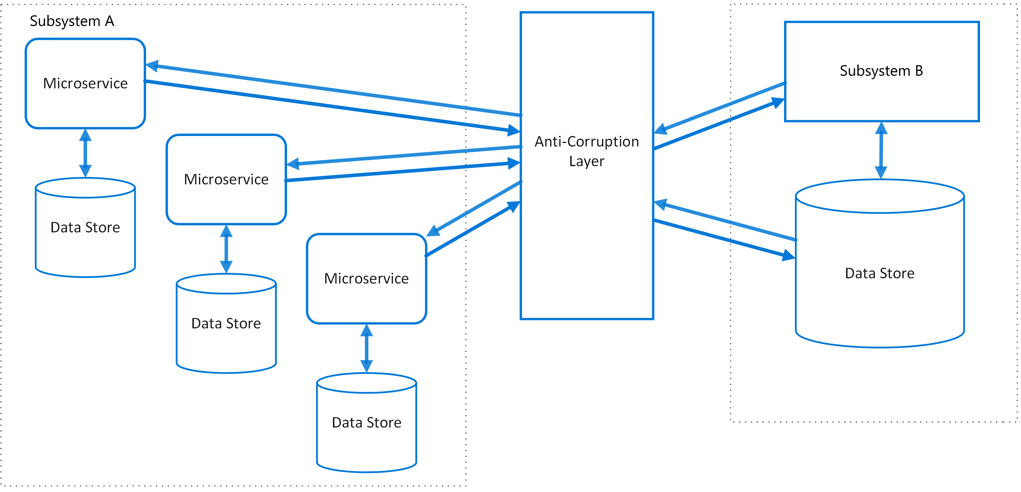
Solution
Anti-Corruption Layer
Isolate the different subsystems by placing an anti-corruption layer between them
Anti-corruption layer translates communications between the two systems, allowing one system to remain unchanged while the other can avoid compromising its design and technological approach
Notes:
Put client frameworks and libraries into an external process that acts as a proxy between your application and external services
Deploy the proxy on the same host environment as your application to allow control over routing, resilience, security features and to avoid any hostrelated access restrictions
Features that are offloaded to the ambassador can be managed independently of the application. You can update and modify the ambassador without disturbing the application’s legacy functionality
API Management
How we used this pattern in the migration at ASB from an old technology (WCF) to a new one (WebAPI microservices)

Slide 19
Example
Data
Store
MVP WebApp
WCF Service
X
React
SPA
WebAPI
Micro Service

Slide 20
Usage Scenarios
Anti-Corruption Layer
When to use this pattern
A migration is planned to happen over multiple stages, but integration between new and legacy systems needs to be maintained.
Avoid using
If there are no significant semantic differences between new and legacy systems
New and legacy systems have different semantics, but still need to communicate.
Notes:
Use when:
Need to build a common set of client connectivity features for multiple languages or frameworks
Need to offload cross-cutting client connectivity concerns to infrastructure developers or other more specialised teams
Need to support cloud or cluster connectivity requirements in a legacy application or an application that is difficult to modify
Avoid When:
When network request latency is critical. A proxy will introduce some overhead, although minimal, and in some cases this may affect the application.
When client connectivity features are consumed by a single language. In that case, a better option might be a client library that is distributed to the development teams as a package.
When connectivity features cannot be generalised and require deeper integration with the client application.

Slide 21
Backends for Frontends

Slide 22
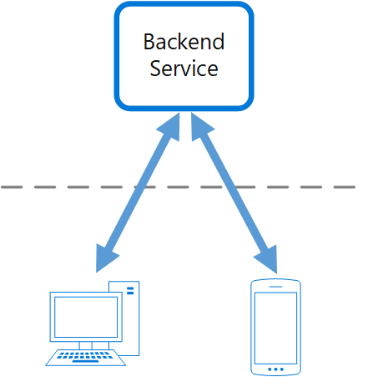
Category, Description, Problem
Backends for Frontends
Category | Interoperability, Management & Monitoring
Description | Create separate backend services to be consumed by specific frontend applications or interfaces.
Problem | Over time multiple frontend applications added to same backend service – Windows Desktop, Web, Mobile Each frontend may have different requirements Frequent changes to Backend as frontend applications are added
Notes:
An application may initially be targeted at a desktop web UI. Typically, a backend service is developed in parallel that provides the features needed for that UI. As the application’s user base grows, a mobile application is developed that must interact with the same backend. The backend service becomes a general-purpose backend, serving the requirements of both the desktop and mobile interfaces. But the capabilities of a mobile device differ significantly from a desktop browser, in terms screen size, performance and display limitations. As a result, the requirements for a mobile application backend differ from the desktop web UI
These differences result in competing requirements for the backend. The backend requires regular and significant changes to serve both the desktop web UI and the mobile application. Often, separate interface teams work on each frontend, causing the backend to become a bottleneck in the development process. Conflicting update requirements, and the need to keep the service working for both frontends, can result in spending a lot of effort on a single deployable resource. As the development activity focuses on the backend service, a separate team may be created to manage and maintain the backend. Ultimately, this results in a disconnect between the interface and backend development teams, placing a burden on the backend team to balance the competing requirements of the different UI teams. When one interface team requires changes to the backend, those changes must be validated with other interface teams before they can be integrated into the backend
ASB example again
Frontend have different experience APIs for its specific purpose
Personalisation
Balance
Dashboard

Slide 23
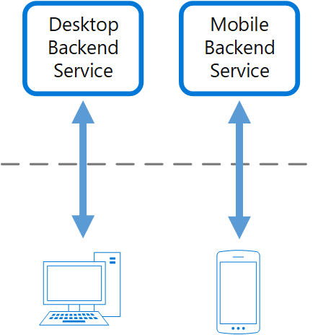
Solution
Backends for Frontends
Create one backend per user interface
Fine tune the behaviour and performance of each backend to best match the needs of the frontend environment
Notes:
Put client frameworks and libraries into an external process that acts as a proxy between your application and external services
Deploy the proxy on the same host environment as your application to allow control over routing, resilience, security features and to avoid any hostrelated access restrictions
Features that are offloaded to the ambassador can be managed independently of the application. You can update and modify the ambassador without disturbing the application’s legacy functionality

Slide 24
Usage Scenarios
Backends for Frontends
When to use this pattern
A shared or general purpose backend service must be maintained with significant development overhead
Avoid using
When interfaces make the same or similar requests to the backend
When only one interface is used to interact with the backend
You want to optimize the backend for the requirements of specific client interfaces
Customizations are made to a general-purpose backend to accommodate multiple interfaces
An alternative language is better suited for the backend of a different user interface
Notes:
A shared or general purpose backend service must be maintained with significant development overhead.
You want to optimize the backend for the requirements of specific client interfaces.
Customizations are made to a general-purpose backend to accommodate multiple interfaces.
An alternative language is better suited for the backend of a different user interface.
This pattern may not be suitable:
When interfaces make the same or similar requests to the backend.
When only one interface is used to interact with the backend.

Slide 25
Bulkhead

Slide 26
Category, Description, Problem
Bulkhead
Category | Availability and Resilience
Description | Isolate elements of an application into pools so that if one fails, the others will continue to function
Problem | Services contained in an application may have several consumers Consumer may send requests to multiple services, one request to a bad service may exhaust client pool. Requests to other services impacted Service with multiple consumers, may have one consumer exhausting resources by sending large number of calls affecting other consumers
Notes:
cloud-based application may include multiple services, with each service having one or more consumers. Excessive load or failure in a service will impact all consumers of the service. Moreover, a consumer may send requests to multiple services simultaneously, using resources for each request. When the consumer sends a request to a service that is misconfigured or not responding, the resources used by the client’s request may not be freed in a timely manner. As requests to the service continue, those resources may be exhausted. For example, the client’s connection pool may be exhausted. At that point, requests by the consumer to other services are impacted. Eventually the consumer can no longer send requests to other services, not just the original unresponsive service. The same issue of resource exhaustion affects services with multiple consumers. A large number of requests originating from one client may exhaust available resources in the service. Other consumers are no longer able to consume the service, causing a cascading failure effect.

Slide 27
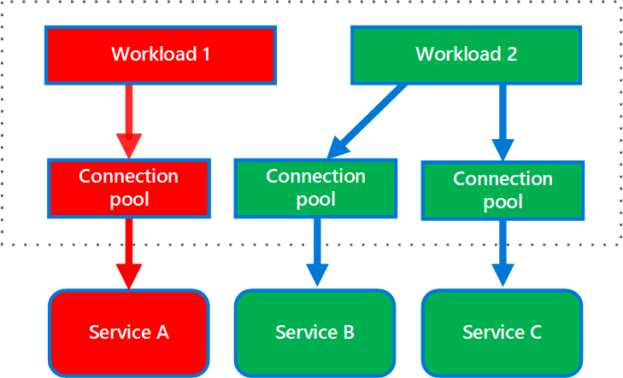
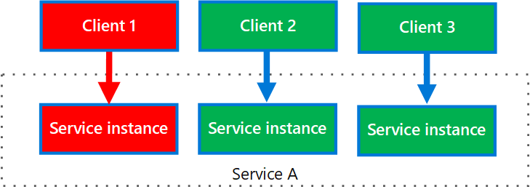
Solution
Bulkhead
Partition service instances into different groups, based on consumer load and availability requirements helping to isolate failures
Allows you to sustain service functionality for some consumers, even during a failure.
A consumer can also partition resources, to ensure that resources used to call one service don’t affect the resources used to call another service
Consumer has Separate pool for each service
Separate Service instance per consumer
Notes:
Partition service instances into different groups, based on consumer load and availability requirements. This design helps to isolate failures and allows you to sustain service functionality for some consumers, even during a failure. A consumer can also partition resources, to ensure that resources used to call one service don’t affect the resources used to call another service. For example, a consumer that calls multiple services may be assigned a connection pool for each service. If a service begins to fail, it only affects the connection pool assigned for that service, allowing the consumer to continue using the other services. The benefits of this pattern include: • Isolates consumers and services from cascading failures. An issue affecting a consumer or service can be isolated within its own bulkhead, preventing the entire solution from failing. • Allows you to preserve some functionality in the event of a service failure. Other services and features of the application will continue to work. • Allows you to deploy services that offer a different quality of service for consuming applications. A high-priority consumer pool can be configured to use high-priority services

Slide 28
Usage Scenarios
Bulkhead
When to use this pattern
Isolate resources used to consume a set of backend services
Avoid using
Less efficient use of resources may not be acceptable in the project.
Isolate critical consumers from standard consumers.
Protect the application from cascading failures
The added complexity is not necessary
Notes:
Use this pattern to: • Isolate resources used to consume a set of backend services, especially if the application can provide some level of functionality even when one of the services is not responding. • Isolate critical consumers from standard consumers. • Protect the application from cascading failures. This pattern may not be suitable when: • Less efficient use of resources may not be acceptable in the project. • The added complexity is not necessary

Slide 29
Cache-Aside

Slide 30
Category, Description, Problem
Cache-Aside
Category | Data Management, Performance and scalability
Description | Load data on demand into a cache from a data store
Problem | Applications use cached data to improve performance Cache data can be stale if not synchronised Need to detect and handle situations when data in cache is stale
Notes:
Applications use a cache to improve repeated access to information held in a data store. However, it’s impractical to expect that cached data will always be completely consistent with the data in the data store. Applications should implement a strategy that helps to ensure that the data in the cache is as up-to-date as possible, but can also detect and handle situations that arise when the data in the cache has become stale.

Slide 31
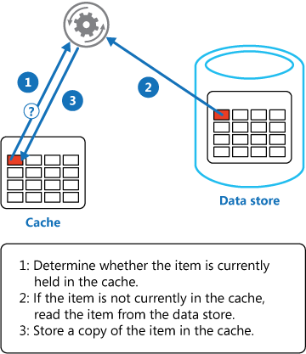
Solution
Cache-Aside
Used by applications where caches don’t provide read-through and write-through/write-behind operations
Read-through caching by implemented using the cacheaside strategy that loads data into the cache on demand.
Write-through strategy implemented by making the modification to the data store and by invalidating the corresponding item in the cache.
When the item is next required, using the Cache-Aside strategy will cause the updated data to be retrieved from the data store and added back into the cache.
Notes:
Many commercial caching systems provide read-through and write-through/write-behind operations. In these systems, an application retrieves data by referencing the cache. If the data isn’t in the cache, it’s retrieved from the data store and added to the cache. Any modifications to data held in the cache are automatically written back to the data store as well.
For caches that don’t provide this functionality, it’s the responsibility of the applications that use the cache to maintain the data. An application can emulate the functionality of read-through caching by implementing the cacheaside strategy. This strategy loads data into the cache on demand. The figure illustrates using the Cache-Aside pattern to store data in the cache.
If an application updates information, it can follow the write-through strategy by making the modification to the data store and by invalidating the corresponding item in the cache. When the item is next required, using the Cache-Aside strategy will cause the updated data to be retrieved from the data store and added back into the cache.

Slide 32
Circuit breaker

Slide 33
Category, Description, Problem
Circuit breaker
Category | Availability and Resiliency
Description | Handle faults that might take a variable amount of time to fix when connecting to a remote service or resource.
Problem | In distributed environment transient faults, such as slow network connections, timeouts etc can cause calls to remote resources and services to fail. This can be fixed using Retry pattern Situations where faults are due to unanticipated events and that might take much longer to fix, ranging in severity from a partial loss of connectivity to the complete failure of a service retrying may be pointless
Notes:
In a distributed environment, calls to remote resources and services can fail due to transient faults, such as slow network connections, timeouts or the resources being overcommitted or temporarily unavailable. These faults typically correct themselves after a short period of time and a robust cloud application should be prepared to handle them by using a strategy such as the Retry pattern. However, there can also be situations where faults are due to unanticipated events and that might take much longer to fix. These faults can range in severity from a partial loss of connectivity to the complete failure of a service. In these situations it might be pointless for an application to continually retry an operation that is unlikely to succeed and instead the application should quickly accept that the operation has failed and handle this failure accordingly. Additionally, if a service is very busy, failure in one part of the system might lead to cascading failures. For example, an operation that invokes a service could be configured to implement a timeout and reply with a failure message if the service fails to respond within this period. However, this strategy could cause many concurrent requests to the same operation to be blocked until the timeout period expires. These blocked requests might hold critical system resources such as memory, threads, database connections and so on. Consequently, these resources could become exhausted, causing failure of other possibly unrelated parts of the system that need to use the same resources. In these situations, it would be preferable for the operation to fail immediately and only attempt to invoke the service if it’s likely to succeed. Note that setting a shorter timeout might help to resolve this problem, but the timeout shouldn’t be so short that the operation fails most of the time, even if the request to the service would eventually succeed.

Slide 34
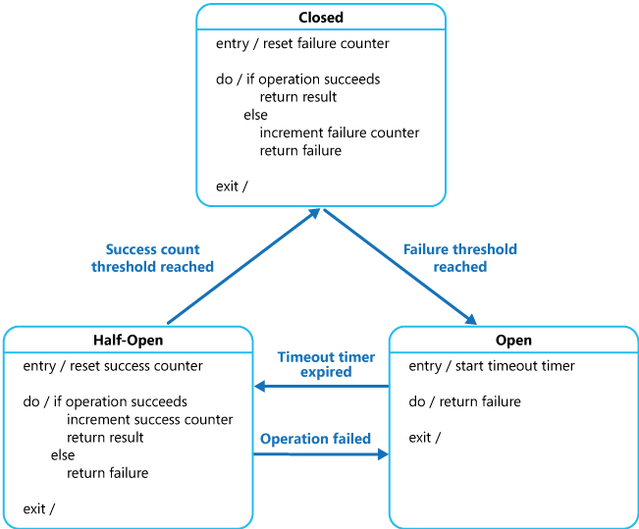
Solution
Circuit breaker
Circuit Breaker pattern can prevent an application from repeatedly trying to execute an operation that’s likely to fail
Circuit Breaker pattern also enables an application to detect whether the fault has been resolved. If the problem appears to have been fixed, the application can try to invoke the operation.
A circuit breaker acts as a proxy for operations that might fail, implemented as a state machine with the following states that mimic the functionality of an electrical circuit breaker – Closed, Open, Half-Open
Notes:
Solution The Circuit Breaker pattern can prevent an application from repeatedly trying to execute an operation that’s likely to fail. Allowing it to continue without waiting for the fault to be fixed or wasting CPU cycles while it determines that the fault is long lasting. The Circuit Breaker pattern also enables an application to detect whether the fault has been resolved. If the problem appears to have been fixed, the application can try to invoke the operation. The purpose of the Circuit Breaker pattern is different than the Retry pattern. The Retry pattern enables an application to retry an operation in the expectation that it’ll succeed. The Circuit Breaker pattern prevents an application from performing an operation that is likely to fail. An application can combine these two patterns by using the Retry pattern to invoke an operation through a circuit breaker. However, the retry logic should be sensitive to any exceptions returned by the circuit breaker and abandon retry attempts if the circuit breaker indicates that a fault is not transient. A circuit breaker acts as a proxy for operations that might fail. The proxy should monitor the number of recent failures that have occurred, and use this information to decide whether to allow the operation to proceed or simply return an exception immediately. The proxy can be implemented as a state machine with the following states that mimic the functionality of an electrical circuit breaker: • Closed: The request from the application is routed to the operation. The proxy maintains a count of the number of recent failures and if the call to the operation is unsuccessful the proxy increments this count. If the number of recent failures exceeds a specified threshold within a given time period, the proxy is placed into the Open state. At this point the proxy starts a timeout timer and when this timer expires the proxy is placed into the Half-Open state. • The purpose of the timeout timer is to give the system time to fix the problem that caused the failure before allowing the application to try to perform the operation again. • Open: The request from the application fails immediately and an exception is returned to the application. • Half-Open: A limited number of requests from the application are allowed to pass through and invoke the operation. If these requests are successful, it’s assumed that the fault that was previously causing the failure has been fixed and the circuit breaker switches to the Closed state (the failure counter is reset). If any request fails, the circuit breaker assumes that the fault is still present so it reverts back to the Open state and restarts the timeout timer to give the system a further period of time to recover from the failure. • The Half-Open state is useful to prevent a recovering service from suddenly being flooded with requests. As a service recovers, it might be able to support a limited volume of requests until the recovery is complete, but while recovery is in progress a flood of work can cause the service to time out or fail again.

Slide 35
Usage Scenarios
Circuit breaker
When to use this pattern
To prevent an application from trying to invoke a remote service or access a shared resource if this operation is highly likely to fail
Avoid using
For handling access to local private resources in an application, such as in-memory data structure
As a substitute for handling exceptions in the business logic of your applications.
Consider the following when implementing – Exception Handling, Logging, Recoverability, Concurrency, Manual Override
Notes:
Issues and considerations You should consider the following points when deciding how to implement this pattern: Exception handling. An application invoking an operation through a circuit breaker must be prepared to handle the exceptions raised if the operation is unavailable. The way exceptions are handled will be application specific. For example, an application could temporarily degrade its functionality, invoke an alternative operation to try to perform the same task or obtain the same data or report the exception to the user and ask them to try again later. Types of exceptions. A request might fail for many reasons, some of which might indicate a more severe type of failure than others. For example, a request might fail because a remote service has crashed and will take several minutes to recover or because of a timeout due to the service being temporarily overloaded. A circuit breaker might be able to examine the types of exceptions that occur and adjust its strategy depending on the nature of these exceptions. For example, it might require a larger number of timeout exceptions to trip the circuit breaker to the Open state compared to the number of failures due to the service being completely unavailable. Logging. A circuit breaker should log all failed requests (and possibly successful requests) to enable an administrator to monitor the health of the operation. Recoverability. You should configure the circuit breaker to match the likely recovery pattern of the operation it’s protecting. For example, if the circuit breaker remains in the Open state for a long period, it could raise exceptions even if the reason for the failure has been resolved. Similarly, a circuit breaker could fluctuate and reduce the response times of applications if it switches from the Open state to the Half-Open state too quickly. Testing failed operations. In the Open state, rather than using a timer to determine when to switch to the Half-Open state, a circuit breaker can instead periodically ping the remote service or resource to determine whether it’s become available again. This ping could take the form of an attempt to invoke an operation that had previously failed or it could use a special operation provided by the remote service specifically for testing the health of the service, as described by the Health Endpoint Monitoring pattern. Manual override. In a system where the recovery time for a failing operation is extremely variable, it’s beneficial to provide a manual reset option that enables an administrator to close a circuit breaker (and reset the failure counter). Similarly, an administrator could force a circuit breaker into the Open state (and restart the timeout timer) if the operation protected by the circuit breaker is temporarily unavailable. Concurrency. The same circuit breaker could be accessed by a large number of concurrent instances of an application. The implementation shouldn’t block concurrent requests or add excessive overhead to each call to an operation. Resource differentiation. Be careful when using a single circuit breaker for one type of resource if there might be multiple underlying independent providers. For example, in a data store that contains multiple shards, one shard might be fully accessible while another is experiencing a temporary issue. If the error responses in these scenarios are merged, an application might try to access some shards even when failure is highly likely, while access to other shards might be blocked even though it’s likely to succeed. Accelerated circuit breaking. Sometimes a failure response can contain enough information for the circuit breaker to trip immediately and stay tripped for a minimum amount of time. For example, the error response from a shared resource that’s overloaded could indicate that an immediate retry isn’t recommended and that the application should instead try again in a few minutes. Replaying failed requests. In the Open state, rather than simply failing quickly, a circuit breaker could also record the details of each request to a journal and arrange for these requests to be replayed when the remote resource or service becomes available. Inappropriate timeouts on external services. A circuit breaker might not be able to fully protect applications from operations that fail in external services that are configured with a lengthy timeout period. If the timeout is too long, a thread running a circuit breaker might be blocked for an extended period before the circuit breaker indicates that the operation has failed. In this time, many other application instances might also try to invoke the service through the circuit breaker and tie up a significant number of threads before they all fail.

Slide 36
CQRS

Slide 37
Category, Description, Problem
CQRS
Category | Data Management, Performance and Scalability
Description | Segregate operations that read data from operations that update data by using separate interfaces
Problem | Traditional data management CRUD operations are applied to the same data model may present following problems Mismatch between the read and write representations of the data, like additional columns that must be updated correctly even though they aren’t required as part of an operation Locks on data pose an issue Managing security is more complex as both read and write operations are allowed on the same entity
Notes:
Traditional CRUD designs work well when only limited business logic is applied to the data operations. Scaffold mechanisms provided by development tools can create data access code very quickly, which can then be customised as required. However, the traditional CRUD approach has some disadvantages: • It often means that there’s a mismatch between the read and write representations of the data, such as additional columns or properties that must be updated correctly even though they aren’t required as part of an operation. • It risks data contention when records are locked in the data store in a collaborative domain, where multiple actors operate in parallel on the same set of data. Or update conflicts caused by concurrent updates when optimistic locking is used. These risks increase as the complexity and throughput of the system grows. In addition, the traditional approach can have a negative effect on performance due to load on the data store and data access layer, and the complexity of queries required to retrieve information. • It can make managing security and permissions more complex because each entity is subject to both read and write operations, which might expose data in the wrong context.

Slide 38
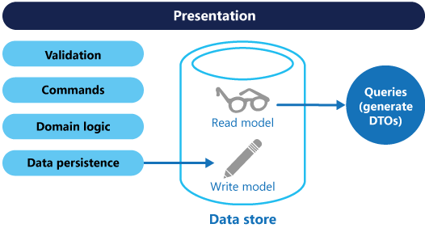
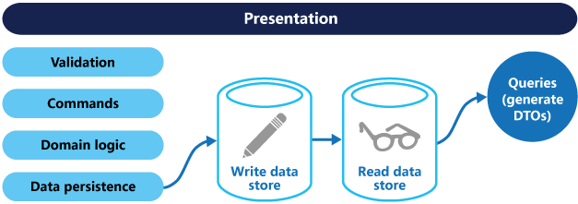
Solution
CQRS
Command and Query Responsibility Segregation (CQRS) is a pattern that segregates the operations that read data (queries) from the operations that update data (commands) by using separate data models
The query model for reading data and the update model for writing data can access the same physical store or they can be access separate different physical stores for read and write to maximise performance, scalability and security,
Single Store
Multiple stores
Notes:
Command and Query Responsibility Segregation (CQRS) is a pattern that segregates the operations that read data (queries) from the operations that update data (commands) by using separate interfaces. This means that the data models used for querying and updates are different
Compared to the single data model used in CRUD-based systems, the use of separate query and update models for the data in CQRS-based systems simplifies design and implementation. However, one disadvantage is that unlike CRUD designs, CQRS code can’t automatically be generated using scaffold mechanisms. The query model for reading data and the update model for writing data can access the same physical store, perhaps by using SQL views or by generating projections on the fly. However, it’s common to separate the data into different physical stores to maximise performance, scalability and security
The read store can be a read-only replica of the write store or the read and write stores can have a different structure altogether. Using multiple read-only replicas of the read store can greatly increase query performance and application UI responsiveness, especially in distributed scenarios where read-only replicas are located close to the application instances. Some database systems (SQL Server) provide additional features such as failover replicas to maximise availability. Separation of the read and write stores also allows each to be scaled appropriately to match the load. For example, read stores typically encounter a much higher load than write stores.

Slide 39
Usage Scenarios
CQRS
When to use this pattern
Many users access the same data in parallel
Avoid using
For handling access to local private resources in an application, such as in-memory data structure
As a substitute for handling exceptions in the business logic of your applications.
Task-based user interfaces where users are guided through a complex process as a series of steps or with complex domain models
Performance of data reads must be fine-tuned separately from performance of data writes. Reads are much more than writes
Separate developer teams can work on read and write models and models evolve over time
Read and write models can be scaled independently
Notes:
Consider CQRS for the following scenarios:
Collaborative domains where many users access the same data in parallel. CQRS allows you to define commands with enough granularity to minimize merge conflicts at the domain level, and conflicts that do arise can be merged by the command.
Task-based user interfaces where users are guided through a complex process as a series of steps or with complex domain models. The write model has a full command-processing stack with business logic, input validation, and business validation. The write model may treat a set of associated objects as a single unit for data changes (an aggregate, in DDD terminology) and ensure that these objects are always in a consistent state. The read model has no business logic or validation stack, and just returns a DTO for use in a view model. The read model is eventually consistent with the write model.
Scenarios where performance of data reads must be fine-tuned separately from performance of data writes, especially when the number of reads is much greater than the number of writes. In this scenario, you can scale out the read model, but run the write model on just a few instances. A small number of write model instances also helps to minimize the occurrence of merge conflicts.
Scenarios where one team of developers can focus on the complex domain model that is part of the write model, and another team can focus on the read model and the user interfaces.
Scenarios where the system is expected to evolve over time and might contain multiple versions of the model, or where business rules change regularly.
Integration with other systems, especially in combination with event sourcing, where the temporal failure of one subsystem shouldn't affect the availability of the others.
This pattern isn't recommended when:
The domain or the business rules are simple.
A simple CRUD-style user interface and data access operations are sufficient.
Consider applying CQRS to limited sections of your system where it will be most valuable.
Benefits of CQRS include:
Independent scaling. CQRS allows the read and write workloads to scale independently, and may result in fewer lock contentions.
Optimized data schemas. The read side can use a schema that is optimized for queries, while the write side uses a schema that is optimized for updates.
Security. It's easier to ensure that only the right domain entities are performing writes on the data.
Separation of concerns. Segregating the read and write sides can result in models that are more maintainable and flexible. Most of the complex business logic goes into the write model. The read model can be relatively simple.
Simpler queries. By storing a materialized view in the read database, the application can avoid complex joins when querying.

Slide 40
Compensating Transaction

Slide 41
Category, Description, Problem
Compensating Transaction
Category | Availability and Resiliency
Description | Undo the work performed by a series of steps, which together define an eventually consistent operation
Problem | In modern applications where data may be spread across multiple data stores in different locations, eventual consistency is used over strong transactional consistency to improve performance Eventual consistency has a challenge of how to handle a step that has failed. All the previous steps in the operation will have to be undone, and data brough back to consistent state
Notes:
Context and problem
Applications running in the cloud frequently modify data. This data might be spread across various data sources held in different geographic locations. To avoid contention and improve performance in a distributed environment, an application shouldn't try to provide strong transactional consistency. Rather, the application should implement eventual consistency. In this model, a typical business operation consists of a series of separate steps. While these steps are being performed, the overall view of the system state might be inconsistent, but when the operation has completed and all of the steps have been executed the system should become consistent again.
The Data Consistency Primer provides information about why distributed transactions don't scale well, and the principles of the eventual consistency model.
A challenge in the eventual consistency model is how to handle a step that has failed. In this case it might be necessary to undo all of the work completed by the previous steps in the operation. However, the data can't simply be rolled back because other concurrent instances of the application might have changed it. Even in cases where the data hasn't been changed by a concurrent instance, undoing a step might not simply be a matter of restoring the original state. It might be necessary to apply various business-specific rules (see the travel website described in the Example section).
If an operation that implements eventual consistency spans several heterogeneous data stores, undoing the steps in the operation will require visiting each data store in turn. The work performed in every data store must be undone reliably to prevent the system from remaining inconsistent.
Not all data affected by an operation that implements eventual consistency might be held in a database. In a service oriented architecture (SOA) environment an operation could invoke an action in a service, and cause a change in the state held by that service. To undo the operation, this state change must also be undone. This can involve invoking the service again and performing another action that reverses the effects of the first.

Slide 42
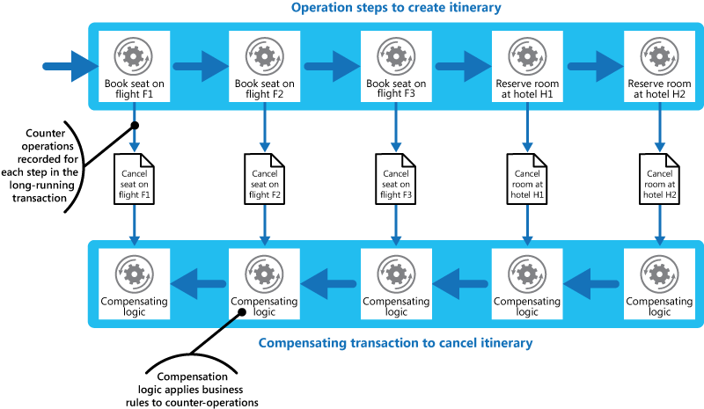
Solution
Compensating Transaction
Implement a compensating transaction to undo the effects of the steps in the original operation
A compensating transaction is not as simple as replacing the current state with the state the system was in at the start of the operation because this approach could overwrite changes made by other concurrent instances of an application
It must be implemented as an intelligent process that takes into account any work done by concurrent instances. This process will usually be application specific, driven by the nature of the work performed by the original operation
An Example
Notes:
Command and Query Responsibility Segregation (CQRS) is a pattern that segregates the operations that read data (queries) from the operations that update data (commands) by using separate interfaces. This means that thahe solution is to implement a compensating transaction. The steps in a compensating transaction must undo the effects of the steps in the original operation. A compensating transaction might not be able to simply replace the current state with the state the system was in at the start of the operation because this approach could overwrite changes made by other concurrent instances of an application. Instead, it must be an intelligent process that takes into account any work done by concurrent instances. This process will usually be application specific, driven by the nature of the work performed by the original operation.
A common approach is to use a workflow to implement an eventually consistent operation that requires compensation. As the original operation proceeds, the system records information about each step and how the work performed by that step can be undone. If the operation fails at any point, the workflow rewinds back through the steps it's completed and performs the work that reverses each step. Note that a compensating transaction might not have to undo the work in the exact reverse order of the original operation, and it might be possible to perform some of the undo steps in parallel.
This approach is similar to the Sagas strategy discussed in Clemens Vasters’ blog.
A compensating transaction is also an eventually consistent operation and it could also fail. The system should be able to resume the compensating transaction at the point of failure and continue. It might be necessary to repeat a step that's failed, so the steps in a compensating transaction should be defined as idempotent commands. For more information, see Idempotency Patterns on Jonathan Oliver’s blog.
In some cases it might not be possible to recover from a step that has failed except through manual intervention. In these situations the system should raise an alert and provide as much information as possible about the reason for the failure.
e data models used for querying and updates are different
Compared to the single data model used in CRUD-based systems, the use of separate query and update models for the data in CQRS-based systems simplifies design and implementation. However, one disadvantage is that unlike CRUD designs, CQRS code can’t automatically be generated using scaffold mechanisms. The query model for reading data and the update model for writing data can access the same physical store, perhaps by using SQL views or by generating projections on the fly. However, it’s common to separate the data into different physical stores to maximise performance, scalability and security
The read store can be a read-only replica of the write store or the read and write stores can have a different structure altogether. Using multiple read-only replicas of the read store can greatly increase query performance and application UI responsiveness, especially in distributed scenarios where read-only replicas are located close to the application instances. Some database systems (SQL Server) provide additional features such as failover replicas to maximise availability. Separation of the read and write stores also allows each to be scaled appropriately to match the load. For example, read stores typically encounter a much higher load than write stores.

Slide 43
Usage Scenarios
Compensating Transaction
When to use this pattern
Use this pattern only for operations that must be undone if they fail
If possible, design solutions to avoid the complexity of requiring compensating transactions.

Slide 44
Federated Identity

Slide 45
Category, Description, Problem
Federated Identity
Category | Security
Description | Delegate authentication to an external identity provider
Problem | In an organization today users may need to access different multiple applications hosted by the organization itself or its partners. Each application may need different credentials often leading to the following: Disjointed user experience – users need to remember multiple credentials Expose security vulnerabilities Complicate user management
Notes:
Context and problem
Users typically need to work with multiple applications provided and hosted by different organizations they have a business relationship with. These users might be required to use specific (and different) credentials for each one. This can:
Cause a disjointed user experience. Users often forget sign-in credentials when they have many different ones.
Expose security vulnerabilities. When a user leaves the company the account must immediately be deprovisioned. It's easy to overlook this in large organizations.
Complicate user management. Administrators must manage credentials for all of the users, and perform additional tasks such as providing password reminders.
Users typically prefer to use the same credentials for all these applications.

Slide 46
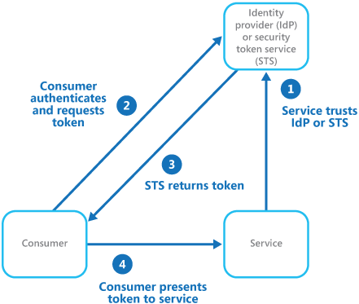
Solution
Federated Identity
Separate user authentication from application code where authentication is delegated to an trusted identity provider
Trusted identity providers include corporate directories, on-premises federation services, other security token services (STS) provided by business partners, or social identity providers that can authenticate users who have, for example, a Microsoft, Google, Yahoo!, or Facebook account
Notes:
Solution
Implement an authentication mechanism that can use federated identity. Separate user authentication from the application code, and delegate authentication to a trusted identity provider. This can simplify development and allow users to authenticate using a wider range of identity providers (IdP) while minimizing the administrative overhead. It also allows you to clearly decouple authentication from authorization.
The trusted identity providers include corporate directories, on-premises federation services, other security token services (STS) provided by business partners, or social identity providers that can authenticate users who have, for example, a Microsoft, Google, Yahoo!, or Facebook account.
The figure illustrates the Federated Identity pattern when a client application needs to access a service that requires authentication. The authentication is performed by an IdP that works in concert with an STS. The IdP issues security tokens that provide information about the authenticated user. This information, referred to as claims, includes the user’s identity, and might also include other information such as role membership and more granular access rights.

Slide 47
Usage Scenarios
Federated Identity
When to use this pattern
Single sign-on in the enterprise
Avoid using
Users are authenticated by a single identity provider
Federated identity with multiple partners
Federated identity in SaaS applications
Application is using legacy authentication mechanism that does not support claims- based authentication and access control
Notes:
When to use this pattern
This pattern is useful for scenarios such as:
Single sign-on in the enterprise. In this scenario you need to authenticate employees for corporate applications that are hosted in the cloud outside the corporate security boundary, without requiring them to sign in every time they visit an application. The user experience is the same as when using on-premises applications where they're authenticated when signing in to a corporate network, and from then on have access to all relevant applications without needing to sign in again.
Federated identity with multiple partners. In this scenario you need to authenticate both corporate employees and business partners who don't have accounts in the corporate directory. This is common in business-to-business applications, applications that integrate with third-party services, and where companies with different IT systems have merged or shared resources.
Federated identity in SaaS applications. In this scenario independent software vendors provide a ready-to-use service for multiple clients or tenants. Each tenant authenticates using a suitable identity provider. For example, business users will use their corporate credentials, while consumers and clients of the tenant will use their social identity credentials.
This pattern might not be useful in the following situations:
All users of the application can be authenticated by one identity provider, and there's no requirement to authenticate using any other identity provider. This is typical in business applications that use a corporate directory (accessible within the application) for authentication, by using a VPN, or (in a cloud-hosted scenario) through a virtual network connection between the on-premises directory and the application.
The application was originally built using a different authentication mechanism, perhaps with custom user stores, or doesn't have the capability to handle the negotiation standards used by claims-based technologies. Retrofitting claims-based authentication and access control into existing applications can be complex, and probably not cost effective.

Slide 48
Gatekeeper

Slide 49
Category, Description, Problem
Gatekeeper
Category | Security
Description | Protect applications and services by using a dedicated host instance that acts as a broker between clients and the application or service, validates and sanitises requests and passes requests and data between them.
Problem | Applications hosted on the cloud expose endpoints that clients can connect to, implementing code to process the client requests This code can be handling authentication, validation and request processing that also could be connecting to backend systems that are critical like data stores If this is compromised it can compromise the security and integrity of the backend systems making them vulnerable to attacks
Notes:
Context and problem
Applications expose their functionality to clients by accepting and processing requests. In cloud-hosted scenarios, applications expose endpoints clients connect to, and typically include the code to handle the requests from clients. This code performs authentication and validation, some or all request processing, and is likely to accesses storage and other services on behalf of the client.
If a malicious user is able to compromise the system and gain access to the application’s hosting environment, the security mechanisms it uses such as credentials and storage keys, and the services and data it accesses, are exposed. As a result, the malicious user can gain unrestrained access to sensitive information and other services.

Slide 50
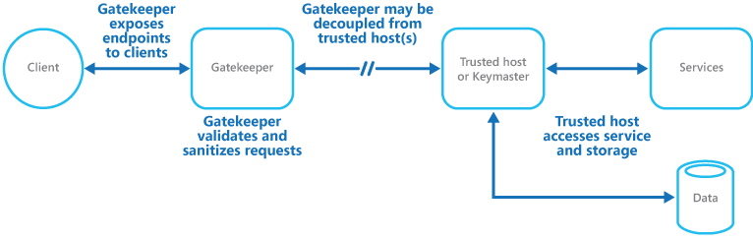
Solution
Gatekeeper
The gatekeeper protect sensitive backend information and services by hosts or tasks that expose public endpoint from the code that processes the requests and accesses the storage
The gatekeeper uses a façade to do the following:
Controlled validation
Limited risk and exposure
Appropriate security
Notes:
Solution
To minimize the risk of clients gaining access to sensitive information and services, decouple hosts or tasks that expose public endpoints from the code that processes requests and accesses storage. You can achieve this by using a façade or a dedicated task that interacts with clients and then hands off the request—perhaps through a decoupled interface—to the hosts or tasks that'll handle the request. The figure provides a high-level overview of this pattern.
The gatekeeper pattern can be used to simply protect storage, or it can be used as a more comprehensive façade to protect all of the functions of the application. The important factors are:
Controlled validation. The gatekeeper validates all requests, and rejects those that don't meet validation requirements.
Limited risk and exposure. The gatekeeper doesn't have access to the credentials or keys used by the trusted host to access storage and services. If the gatekeeper is compromised, the attacker doesn't get access to these credentials or keys.
Appropriate security. The gatekeeper runs in a limited privilege mode, while the rest of the application runs in the full trust mode required to access storage and services. If the gatekeeper is compromised, it can't directly access the application services or data.
This pattern acts like a firewall in a typical network topography. It allows the gatekeeper to examine requests and make a decision about whether to pass the request on to the trusted host that performs the required tasks. This decision typically requires the gatekeeper to validate and sanitize the request content before passing it on to the trusted host.

Slide 51
Usage Scenarios
Gatekeeper
When to use this pattern
Applications that handle sensitive information, expose services that must have a high degree of protection from malicious attacks, or perform mission-critical operations that shouldn't be disrupted.
Distributed applications where it's necessary to perform request validation separately from the main tasks, or to centralize this validation to simplify maintenance and administration.
Notes:
Issues and considerations
Consider the following points when deciding how to implement this pattern:
Ensure that the trusted hosts the gatekeeper passes requests to expose only internal or protected endpoints, and connect only to the gatekeeper. The trusted hosts shouldn't expose any external endpoints or interfaces.
The gatekeeper must run in a limited privilege mode. Typically this means running the gatekeeper and the trusted host in separate hosted services or virtual machines.
The gatekeeper shouldn't perform any processing related to the application or services, or access any data. Its function is purely to validate and sanitize requests. The trusted hosts might need to perform additional validation of requests, but the core validation should be performed by the gatekeeper.
Use a secure communication channel (HTTPS, SSL, or TLS) between the gatekeeper and the trusted hosts or tasks where this is possible. However, some hosting environments don't support HTTPS on internal endpoints.
Adding the extra layer to the application to implement the gatekeeper pattern is likely to have some impact on performance due to the additional processing and network communication it requires.
The gatekeeper instance could be a single point of failure. To minimize the impact of a failure, consider deploying additional instances and using an autoscaling mechanism to ensure capacity to maintain availability.
When to use this pattern
This pattern is useful for:
Applications that handle sensitive information, expose services that must have a high degree of protection from malicious attacks, or perform mission-critical operations that shouldn't be disrupted.
Distributed applications where it's necessary to perform request validation separately from the main tasks, or to centralize this validation to simplify maintenance and administration.

Slide 52
Gateway Aggregation

Slide 53
Category, Description, Problem
Gateway Aggregation
Category | Management and Monitoring, Performance
Description | Use a gateway to aggregate multiple individual requests into a single request
Problem | To perform a task, an application may need to make multiple calls to backend services expending resources on each request. This could lead to chattiness between the application and the services leading to an adverse impact on performance and scalability
Notes:
Context and problem
To perform a single task, a client may have to make multiple calls to various backend services. An application that relies on many services to perform a task must expend resources on each request. When any new feature or service is added to the application, additional requests are needed, further increasing resource requirements and network calls. This chattiness between a client and a backend can adversely impact the performance and scale of the application. Microservice architectures have made this problem more common, as applications built around many smaller services naturally have a higher amount of cross-service calls.
In the following diagram, the client sends requests to each service (1,2,3). Each service processes the request and sends the response back to the application (4,5,6). Over a cellular network with typically high latency, using individual requests in this manner is inefficient and could result in broken connectivity or incomplete requests. While each request may be done in parallel, the application must send, wait, and process data for each request, all on separate connections, increasing the chance of failure.

Slide 54
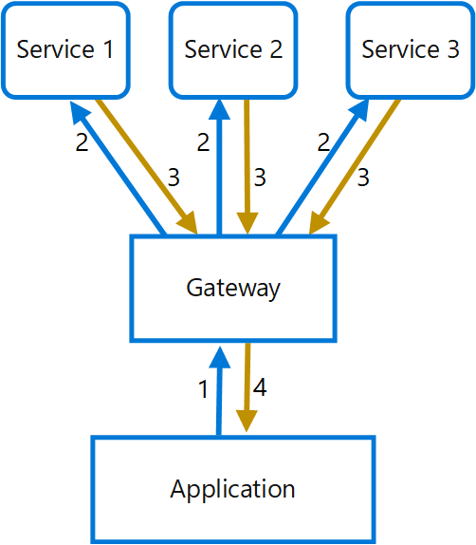
Solution
Gateway Aggregation
A gateway to reduce chattiness between the client and the services
The gateway receives client requests, dispatches requests to the various backend systems, and then aggregates the results and sends them back to the requesting client
This reduces the number of calls application makes to backend services leading to performance improvement over high-latency networks
Notes:
Solution
Use a gateway to reduce chattiness between the client and the services. The gateway receives client requests, dispatches requests to the various backend systems, and then aggregates the results and sends them back to the requesting client.
This pattern can reduce the number of requests that the application makes to backend services, and improve application performance over high-latency networks.
In the following diagram, the application sends a request to the gateway (1). The request contains a package of additional requests. The gateway decomposes these and processes each request by sending it to the relevant service (2). Each service returns a response to the gateway (3). The gateway combines the responses from each service and sends the response to the application (4). The application makes a single request and receives only a single response from the gateway.

Slide 55
Usage Scenarios
Gateway Aggregation
When to use this pattern
A client needs to communicate with multiple backend services to perform an operation.
Avoid using
You want to reduce the number of calls between a client and a single service across multiple operations. In that scenario, it may be better to add a batch operation to the service.
The client may use networks with significant latency, such as cellular networks.
The client or application is located near the backend services and latency is not a significant factor
Notes:
Issues and considerations
The gateway should not introduce service coupling across the backend services.
The gateway should be located near the backend services to reduce latency as much as possible.
The gateway service may introduce a single point of failure. Ensure the gateway is properly designed to meet your application's availability requirements.
The gateway may introduce a bottleneck. Ensure the gateway has adequate performance to handle load and can be scaled to meet your anticipated growth.
Perform load testing against the gateway to ensure you don't introduce cascading failures for services.
Implement a resilient design, using techniques such as bulkheads, circuit breaking, retry, and timeouts.
If one or more service calls takes too long, it may be acceptable to timeout and return a partial set of data. Consider how your application will handle this scenario.
Use asynchronous I/O to ensure that a delay at the backend doesn't cause performance issues in the application.
Implement distributed tracing using correlation IDs to track each individual call.
Monitor request metrics and response sizes.
Consider returning cached data as a failover strategy to handle failures.
Instead of building aggregation into the gateway, consider placing an aggregation service behind the gateway. Request aggregation will likely have different resource requirements than other services in the gateway and may impact the gateway's routing and offloading functionality.

Slide 56
Health Endpoint Monitoring

Slide 57
Category, Description, Problem
Health Endpoint Monitoring
Category | Management and Monitoring, Availability and Resiliency
Description | Implement functional checks in an application that external tools can access through exposed endpoints at regular intervals
Problem | Difficult to monitor applications and services for performance and availability when hosted on cloud as control over hosted environment may be limited Necessary to verify at regular intervals that the service is performing correctly to ensure the required level of availability service level agreement (SLA)
Notes:
Context and problem
It's a good practice, and often a business requirement, to monitor web applications and back-end services, to ensure they're available and performing correctly. However, it's more difficult to monitor services running in the cloud than it is to monitor on-premises services. For example, you don't have full control of the hosting environment, and the services typically depend on other services provided by platform vendors and others.
There are many factors that affect cloud-hosted applications such as network latency, the performance and availability of the underlying compute and storage systems, and the network bandwidth between them. The service can fail entirely or partially due to any of these factors. Therefore, you must verify at regular intervals that the service is performing correctly to ensure the required level of availability, which might be part of your service level agreement (SLA).

Slide 58
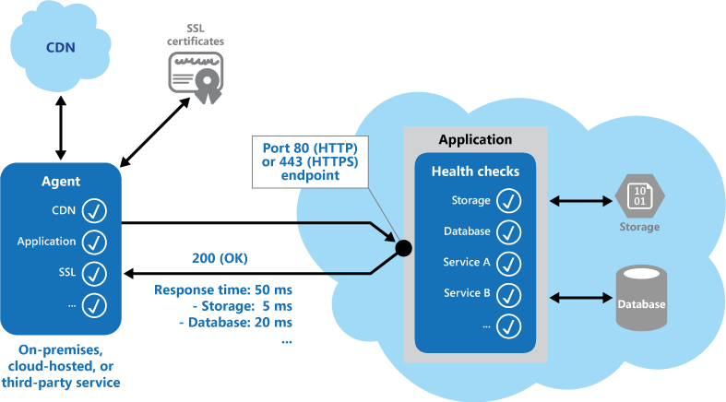
Solution
Health Endpoint Monitoring
Implement a Health monitoring endpoint on the application
Solution involves two factors
The checks (if any) performed by the application or service in response to the request to the health verification endpoint.
Analysis of the results by the tool or framework that performs the health verification check
Notes:
Solution
Implement health monitoring by sending requests to an endpoint on the application. The application should perform the necessary checks, and return an indication of its status.
A health monitoring check typically combines two factors:
The checks (if any) performed by the application or service in response to the request to the health verification endpoint.
Analysis of the results by the tool or framework that performs the health verification check.
The response code indicates the status of the application and, optionally, any components or services it uses. The latency or response time check is performed by the monitoring tool or framework.

Slide 59
Usage Scenarios
Health Endpoint Monitoring
When to use this pattern
Monitoring websites and web applications to verify availability
Monitoring websites and web applications to check for correct operation.
Monitoring middle-tier or shared services to detect and isolate a failure that could disrupt other applications.
Complementing existing instrumentation in the application, such as performance counters and error handlers
Notes:
When to use this pattern
This pattern is useful for:
Monitoring websites and web applications to verify availability.
Monitoring websites and web applications to check for correct operation.
Monitoring middle-tier or shared services to detect and isolate a failure that could disrupt other applications.
Complementing existing instrumentation in the application, such as performance counters and error handlers. Health verification checking doesn't replace the requirement for logging and auditing in the application. Instrumentation can provide valuable information for an existing framework that monitors counters and error logs to detect failures or other issues. However, it can't provide information if the application is unavailable.

Slide 60
Sharding

Slide 61
Category, Description, Problem
Sharding
Category | Data Management, Performance and Scalability
Description | Divide a data store into a set of horizontal partitions or shards
Problem | Traditional data stores are limited by storage space, computing resources, network bandwidth as they are single server deployments. Scale can be achieved by scaling the server box hosting the data, but there is a limit to how much you can scale Modern applications expect huge volumes of data and high number of users from different locations to scale indefinitely Vertical scaling is not the solution
Notes:
Context and problem
A data store hosted by a single server might be subject to the following limitations:
Storage space. A data store for a large-scale cloud application is expected to contain a huge volume of data that could increase significantly over time. A server typically provides only a finite amount of disk storage, but you can replace existing disks with larger ones, or add further disks to a machine as data volumes grow. However, the system will eventually reach a limit where it isn't possible to easily increase the storage capacity on a given server.
Computing resources. A cloud application is required to support a large number of concurrent users, each of which run queries that retrieve information from the data store. A single server hosting the data store might not be able to provide the necessary computing power to support this load, resulting in extended response times for users and frequent failures as applications attempting to store and retrieve data time out. It might be possible to add memory or upgrade processors, but the system will reach a limit when it isn't possible to increase the compute resources any further.
Network bandwidth. Ultimately, the performance of a data store running on a single server is governed by the rate the server can receive requests and send replies. It's possible that the volume of network traffic might exceed the capacity of the network used to connect to the server, resulting in failed requests.
Geography. It might be necessary to store data generated by specific users in the same region as those users for legal, compliance, or performance reasons, or to reduce latency of data access. If the users are dispersed across different countries or regions, it might not be possible to store the entire data for the application in a single data store.
Scaling vertically by adding more disk capacity, processing power, memory, and network connections can postpone the effects of some of these limitations, but it's likely to only be a temporary solution. A commercial cloud application capable of supporting large numbers of users and high volumes of data must be able to scale almost indefinitely, so vertical scaling isn't necessarily the best solution.

Slide 62
Solution
Sharding
Horizontally scaling the database by partitioning or sharding
Each shard has the same schema and stores its own distinct subset of data
Benefits of sharding
Unlimited scale by adding more shards/storage nodes
Commodity hardware can be used
Reduce contention and improve performance by balancing the workload across shards.
In the cloud, shards can be located physically close to the users that'll access the data
Sharding Strategies
Lookup Strategy - sharding logic implements a map that routes a request for data to the shard that contains that data using the shard key
Range Strategy - groups related items together in the same shard, and orders them by shard key—the shard keys are sequential
Hash Strategy - distributes the data across the shards in a way that achieves a balance between the size of each shard and the average load that each shard will encounter
Notes:
Solution
Divide the data store into horizontal partitions or shards. Each shard has the same schema, but holds its own distinct subset of the data. A shard is a data store in its own right (it can contain the data for many entities of different types), running on a server acting as a storage node.
This pattern has the following benefits:
You can scale the system out by adding further shards running on additional storage nodes.
A system can use off-the-shelf hardware rather than specialized and expensive computers for each storage node.
You can reduce contention and improve performance by balancing the workload across shards.
In the cloud, shards can be located physically close to the users that'll access the data.
When dividing a data store up into shards, decide which data should be placed in each shard. A shard typically contains items that fall within a specified range determined by one or more attributes of the data. These attributes form the shard key (sometimes referred to as the partition key). The shard key should be static. It shouldn't be based on data that might change.
Sharding physically organizes the data. When an application stores and retrieves data, the sharding logic directs the application to the appropriate shard. This sharding logic can be implemented as part of the data access code in the application, or it could be implemented by the data storage system if it transparently supports sharding.
Abstracting the physical location of the data in the sharding logic provides a high level of control over which shards contain which data. It also enables data to migrate between shards without reworking the business logic of an application if the data in the shards need to be redistributed later (for example, if the shards become unbalanced). The tradeoff is the additional data access overhead required in determining the location of each data item as it's retrieved.
To ensure optimal performance and scalability, it's important to split the data in a way that's appropriate for the types of queries that the application performs. In many cases, it's unlikely that the sharding scheme will exactly match the requirements of every query. For example, in a multi-tenant system an application might need to retrieve tenant data using the tenant ID, but it might also need to look up this data based on some other attribute such as the tenant’s name or location. To handle these situations, implement a sharding strategy with a shard key that supports the most commonly performed queries.
If queries regularly retrieve data using a combination of attribute values, you can likely define a composite shard key by linking attributes together. Alternatively, use a pattern such as Index Table to provide fast lookup to data based on attributes that aren't covered by the shard key.

Slide 63
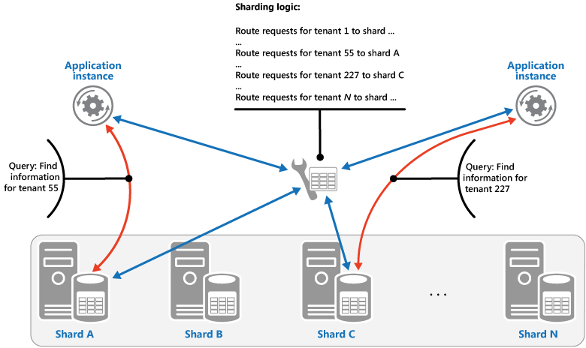
Sharding Strategies - Lookup
Notes:
Lookup. This offers more control over the way that shards are configured and used. Using virtual shards reduces the impact when rebalancing data because new physical partitions can be added to even out the workload. The mapping between a virtual shard and the physical partitions that implement the shard can be modified without affecting application code that uses a shard key to store and retrieve data. Looking up shard locations can impose an additional overhead.

Slide 64
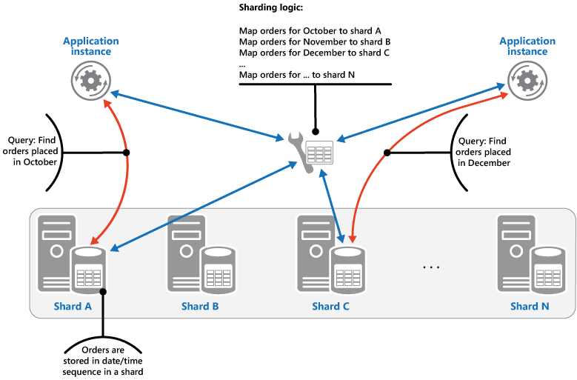
Sharding Strategy - Range
Notes:
Range. This is easy to implement and works well with range queries because they can often fetch multiple data items from a single shard in a single operation. This strategy offers easier data management. For example, if users in the same region are in the same shard, updates can be scheduled in each time zone based on the local load and demand pattern. However, this strategy doesn't provide optimal balancing between shards. Rebalancing shards is difficult and might not resolve the problem of uneven load if the majority of activity is for adjacent shard keys.

Slide 65
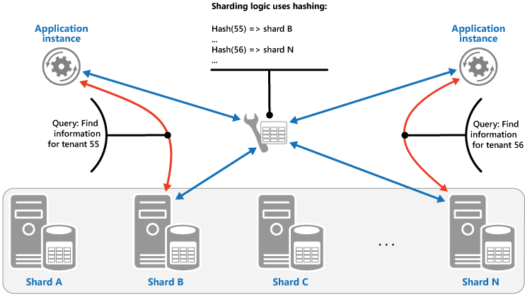
Sharding Strategy - Hash
Notes:
Hash. This strategy offers a better chance of more even data and load distribution. Request routing can be accomplished directly by using the hash function. There's no need to maintain a map. Note that computing the hash might impose an additional overhead. Also, rebalancing shards is difficult.

Slide 66
Usage Scenarios
Sharding
When to use this pattern
Use this pattern when a data store is likely to need to scale beyond the resources available to a single storage node, or to improve performance by reducing contention in a data store

